Slide 1
Assignment 12
Metagenomics
April 10, 2026

Slide 2
Goal
Due Friday April 17th
Download files in /storage1/fs1/workshops/Active/BIO5488/SP2026.L41.BIOL.5488.01/Assignments/A12/Assignment_Data to your local desktop
Use R to analyze what is different between the stool microbiome of mice from these two facilities, using 16S rRNA gene data
What to turn in:
assignment_12.Rmd
README.txt
Notes:
Data comes from two different housing facilities
We want to analyze what is different between the stool microbiome between mice from these two facilities, using 16S rRNA gene data.
We will use R to analyze the data

Slide 3
Step 1. Installation of R and RStudio
R and RStudio Desktop should work on any OS (Mac, Linux, Windows). You will need to install both R and RStudio Desktop. The instructions are pretty detailed and can be found for all OS at https://posit.co/download/rstudio-desktop/
Please be sure to, as shown on the website:
1. Install R, version R-4.1.3 or higher (https://cran.rstudio.com/).
2. Download RStudio Desktop, version 2022.02.1-461 or higher (https://www.rstudio.com/products/rstudio/download/).
Notes:
R is a programming language for statistical computing and data visualization

Slide 4
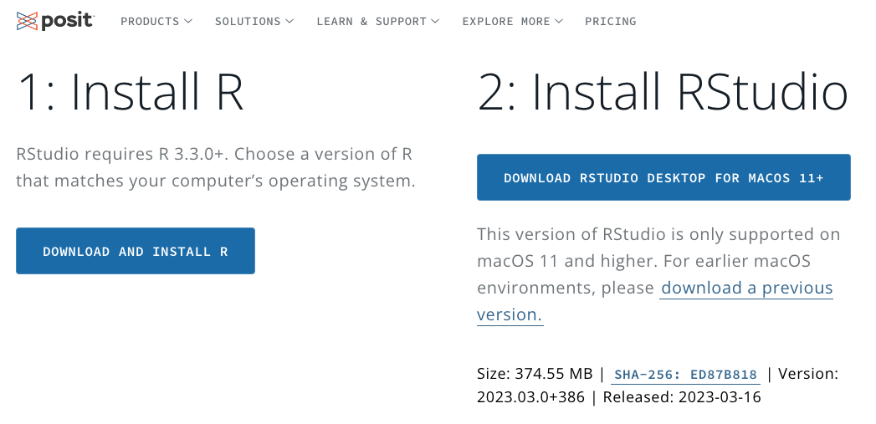
Step 1.1 Install R
https://posit.co/download/rstudio-desktop/
Notes:
\

Slide 5
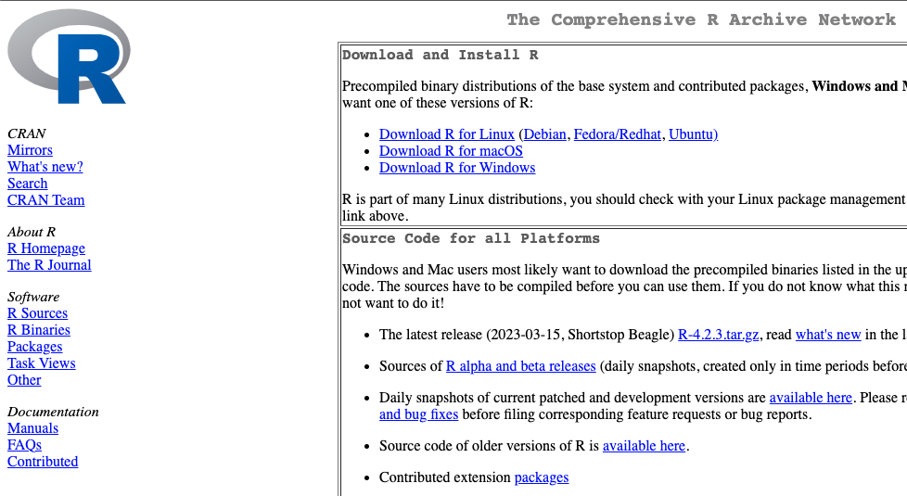
Step 1.1 Install R - choose the R version that fits your operating system
https://cran.rstudio.com/

Slide 6
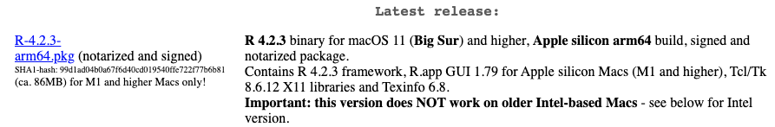
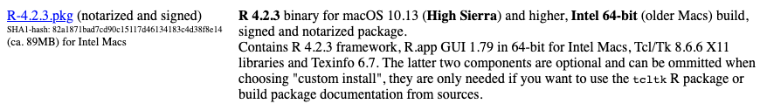
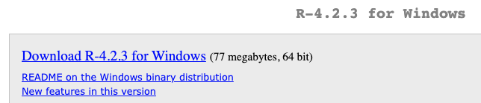
Step 1.1 Install R - choose the R version that fits your operating system
macOS
Apple silicon
macOS
Intel
Windows

Slide 7
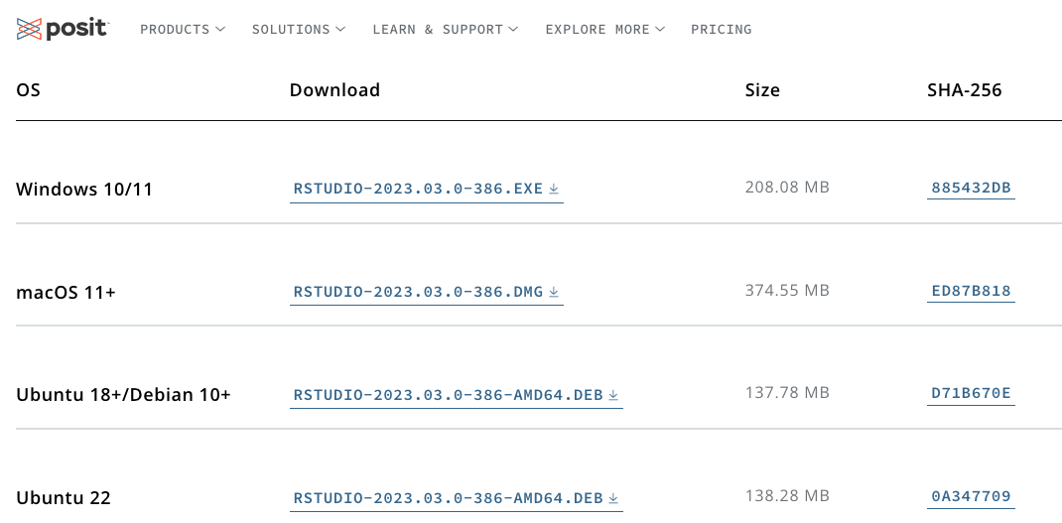
Step 1.2 Install RStudio
https://posit.co/download/rstudio-desktop/

Slide 8
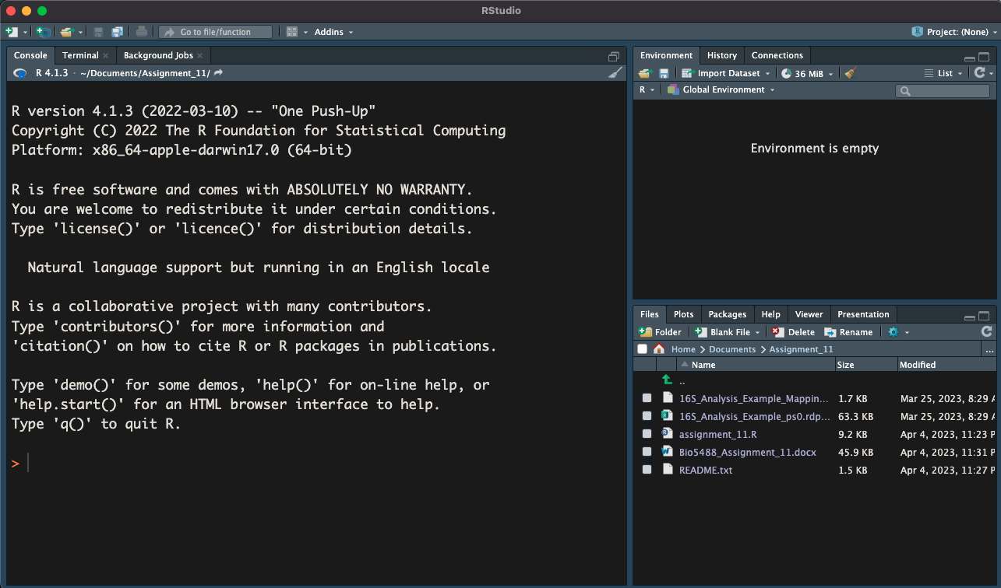
Step 2. Configure RStudio working environment for this homework
List of variables
Interactive R console
Files, plots, packages…

Slide 9
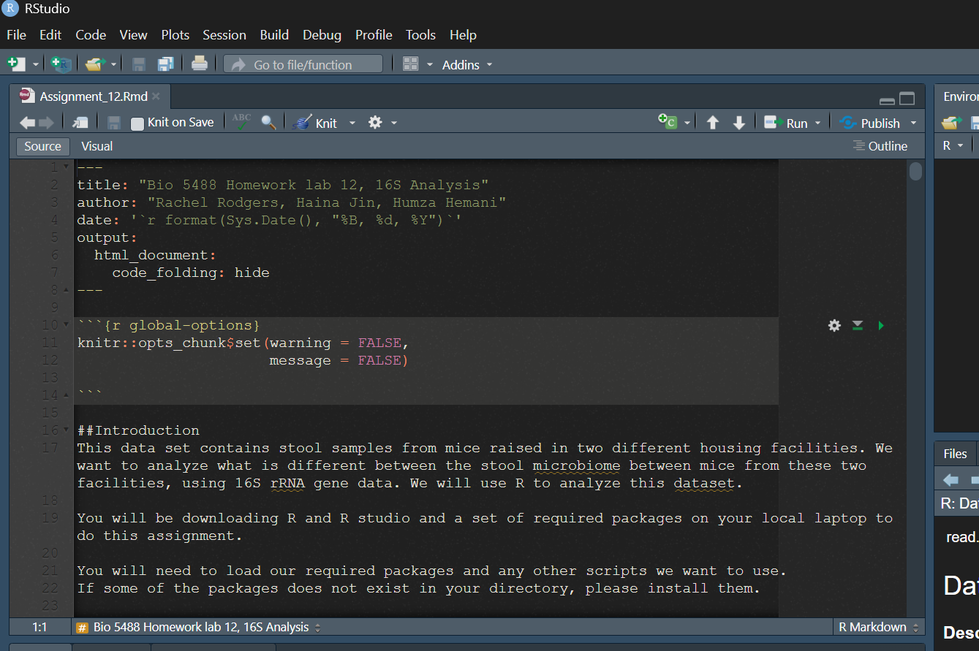
Step 2.1 Open assignment_12.Rmd

Slide 10
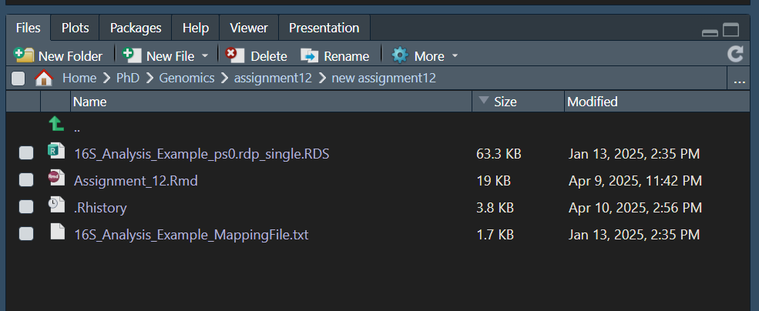
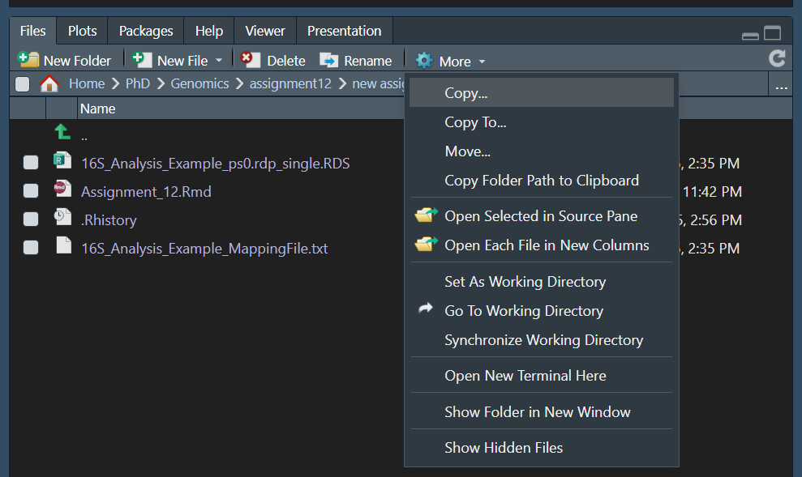
Step 2.2 Set working directory (important)
First, click the … sign to navigate to your working directory where R markdown file and data files are stored
Next, click the ‘gear’ sign
Last, select ‘Set As Working Directory’ option.

Slide 11
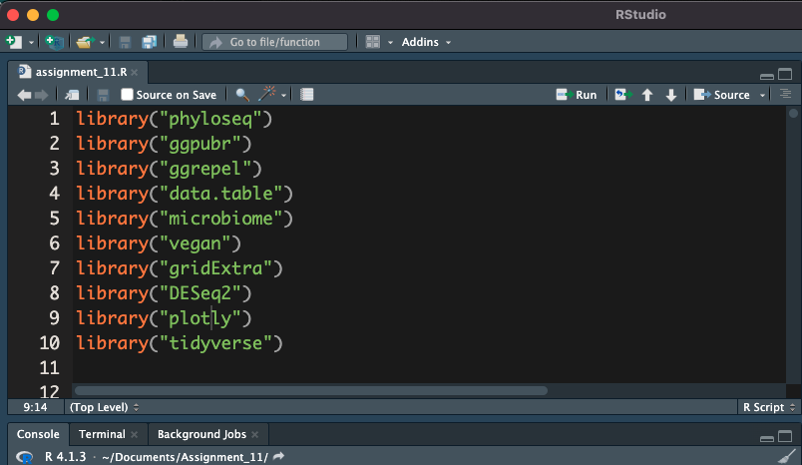
Step 3. Ensure the R packages needed for this assignment are installed
Click Run button to run line by line.
There are keyboard shortcuts for macOS and Windows

Slide 12
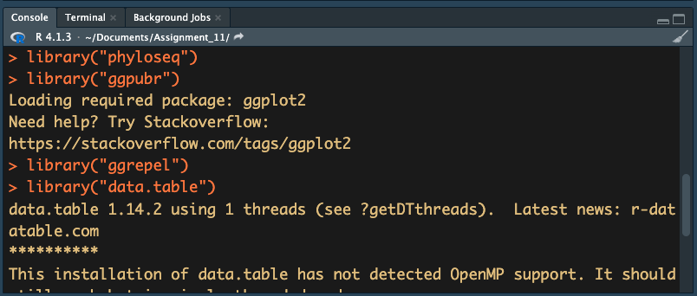
Step 3.1 Loading messages will show up in the Interactive Console if a package has been installed before.
Click Run button to run line by line.
There are keyboard shortcuts for macOS and Windows
If error messages show up, we will need to install the missing packages

Slide 13
Step 3.2 This assignment has two groups of packages which need different installation methods
 | Group 1 | Group 2
Package name | vegan plotly tidyverse gridExtra data.table ggpubr ggrepel BiocManager | Phyloseq Microbiome DESeq2
Installation method | Use the Install button in the packages tab in the bottom right section of the screen (next slide) Use function install.packages() | Use BiocManager::install() function in package BiocManager
Click Run button to run line by line.
There are keyboard shortcuts for macOS and Windows

Slide 14
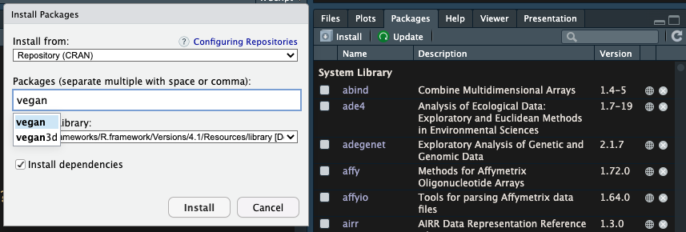
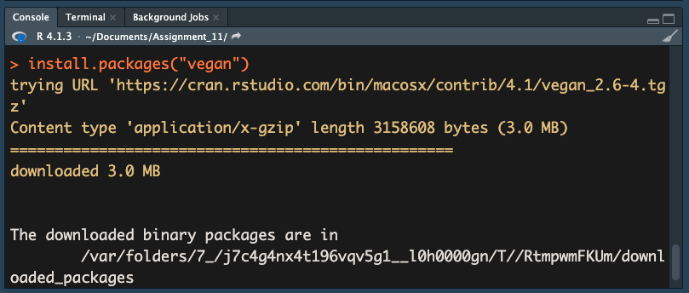
Step 3.3 Install Group 1 packages use either method 1 or 2 or the one you are familiar with
Method 1. Use the Install button in the Packages tab
Method 2. Use function install.packages() in the Interactive Console and hit the Enter button

Slide 15
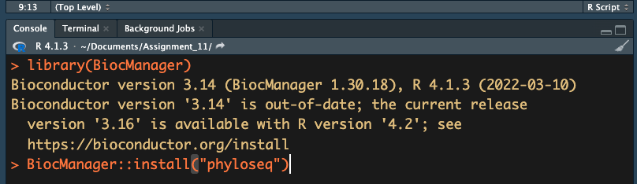
Step 3.4 BiocManager package needs to be loaded to install Group 2 packages
1. Load BiocManager
2. Install Group 2 packages

Slide 16
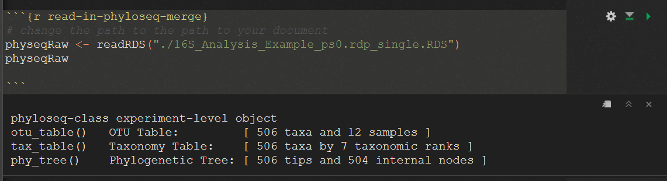
Step 4. Fill out and run each code block in Assignment_12.Rmd. Remember to save your Rmd file for submission!!
Hit the Run button or keyboards shortcuts
Output will show up below each block
Notes:
Tutorial within assignment document

Slide 17
Step 5. Answer questions 1 to 9 in the README.txt
In this assignment, we will use p-value < 0.05 as cut-off for statistical significance.
R use # sign to comment lines without running it.
When you meet errors, try reading through the error message and see if gives you a hint on how to fix it ☺.

Slide 18

Using ggplot
ggplot is a widely used plotting package that makes it easy to customize and layer plot
You first use the ggplot function to specify your data (must be a dataframe), and your mapping (which columns are the x and y axes?),
Then you can add on layers using geom_* functions
https://ggplot2.tidyverse.org/articles/ggplot2.html

Slide 19
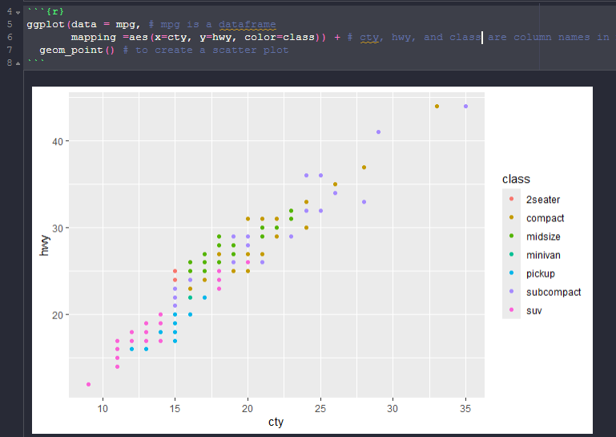
Scatter Plots

Slide 20
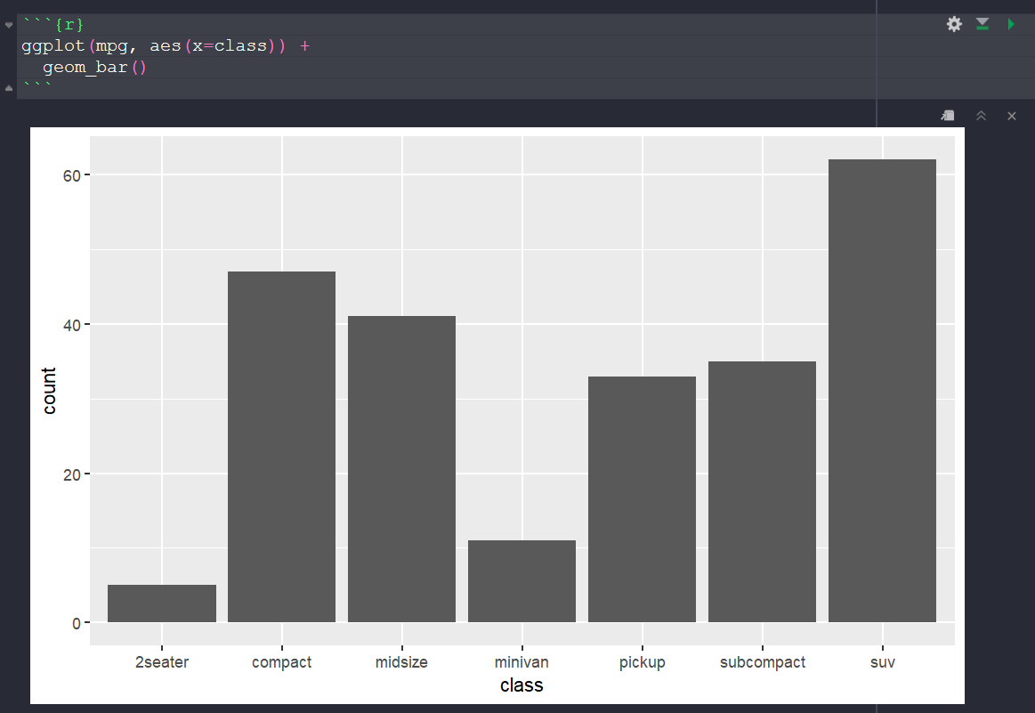
Bar Plots
https://ggplot2.tidyverse.org/articles/ggplot2.html
You can only specify the x axis here – by default it’ll count the number of rows in the dataframe within each class.

Slide 21
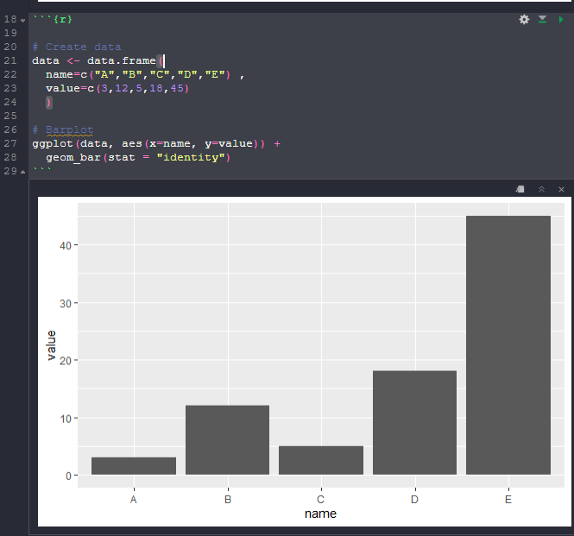
Bar Plots
Alternatively, specify both x and y axes and use stat=“identity”
https://r-graph-gallery.com/218-basic-barplots-with-ggplot2.html

Slide 22
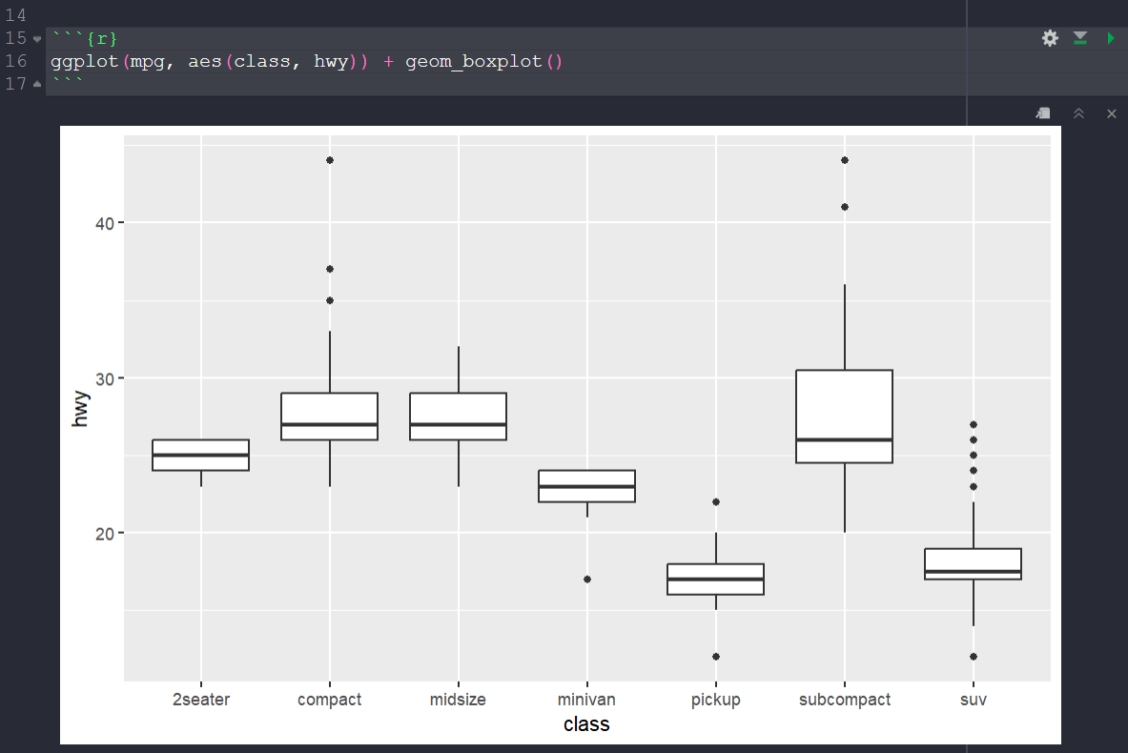
Box and Whisker Plots
https://ggplot2.tidyverse.org/reference/geom_boxplot.html

Slide 23
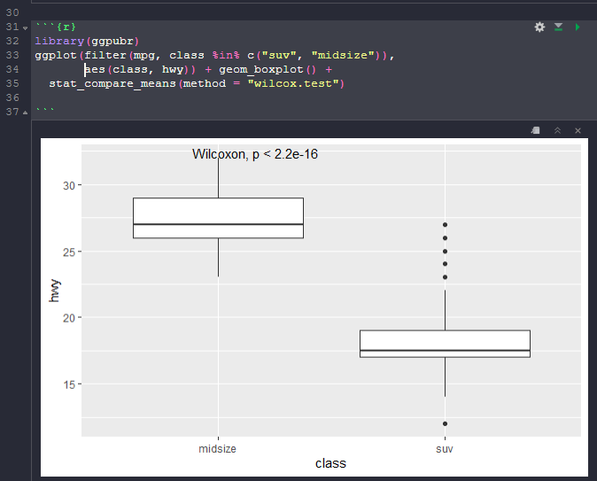
Statistical tests with your plot
https://www.rdocumentation.org/packages/ggpubr/versions/0.6.0/topics/stat_compare_means

Slide 24
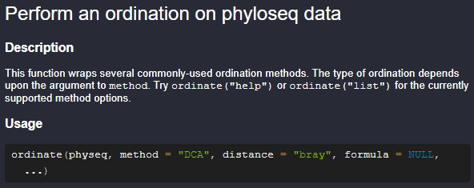
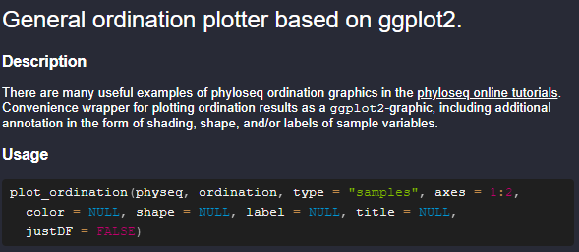
Multidimensional Scaling (MDS)
This is a similar idea to PCA or UMAP
Project data to a 2D space and plot it to see how similar/different each data point is
You can use different distance metrics to measure the difference between samples in different ways
To plot an MDS plot, use ordinate() to create an ordination object, and then use plot_ordination() on that object. (phyloseq package)

Slide 25
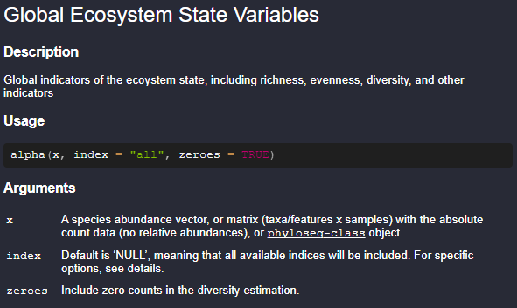
Calculating Alpha Diversity
Alpha function in microbiome package

Slide 26
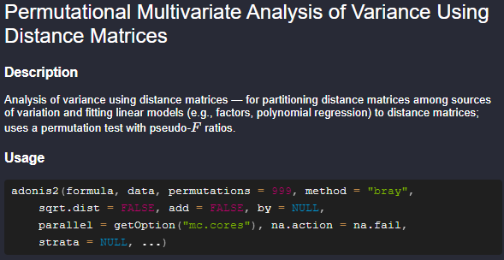
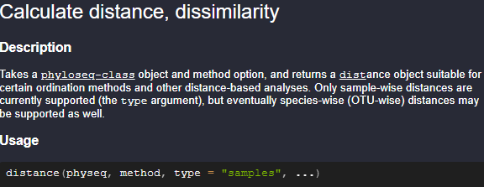
Doing an adonis2 test
adonis2() runs a statistical test used to determine if there are significant differences between the means of two or more groups.
Get a dist object using distance() (phyloseq package) and then use it as the dependent variable in the formula for the adonis2() function
The independent variables must be columns from a dataframe.
adonis2(dep_var1 ~ ind_var1+ind_var2,
data=df) # ind_var1 and ind_var2 are columns in df

